Slide 1

Improvi
Go, change the world
RV College of
Engineering
Unit 2 (Relational Algebra)
Original Content: Ramez Elmasri and Shamkant B. Navathe
Dr. Poonam Ghuli
Associate Professor, Department of CSE
RV College of Engineering, Bengaluru - 59

Slide 2

Chapter Outline
Go, change the world
RV College of
Engineering
Relational Algebra
Unary Relational Operations
Relational Algebra Operations From Set Theory
Binary Relational Operations
Additional Relational Operations
Examples of Queries in Relational Algebra

Slide 3
Relational Algebra Overview
Go, change the world
RV College of
Engineering
Relational algebra is the basic set of operations for the relational model
These operations enable a user to specify basic retrieval requests (or queries)
The result of an operation is a new relation, which may have been formed from one or more input relations
This property makes the algebra “closed” (all objects in relational algebra are relations)

Slide 4
Relational Algebra Overview (continued)
Go, change the world
RV College of
Engineering
The algebra operations thus produce new relations
These can be further manipulated using operations of the same algebra
A sequence of relational algebra operations forms a relational algebra expression
The result of a relational algebra expression is also a relation that represents the result of a database query (or retrieval request)

Slide 5
Relational Algebra Overview
Go, change the world
RV College of
Engineering
Relational Algebra consists of several groups of operations
Unary Relational Operations
SELECT (symbol: σ (sigma))
PROJECT (symbol: π (pi))
RENAME (symbol: ρ (rho))
Relational Algebra Operations From Set Theory
UNION ( ∪ ), INTERSECTION ( ∩ ), DIFFERENCE (or MINUS, – )
CARTESIAN PRODUCT ( x )
Binary Relational Operations
JOIN (several variations of JOIN exist)
DIVISION
Additional Relational Operations
OUTER JOINS, OUTER UNION
AGGREGATE FUNCTIONS (These compute summary of information: for example, SUM, COUNT, AVG, MIN, MAX)

Slide 6
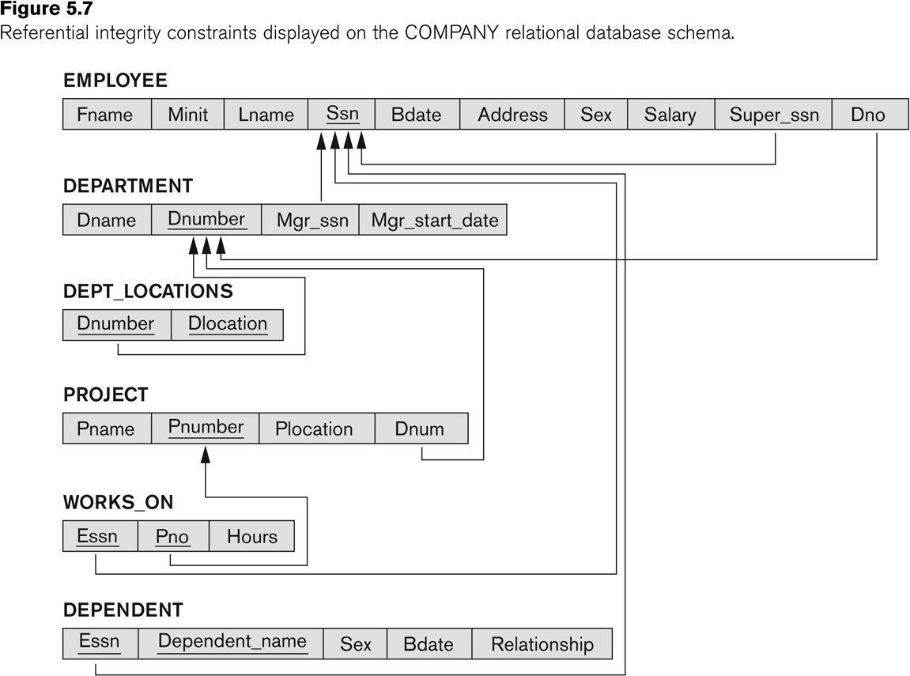
Relational Algebra Overview
Go, change the world
RV College of
Engineering
All examples discussed below refer to the COMPANY database shown here.
Manages : 1:1 relationship type between EMPLOYEE and DEPARTMENT. Employee participation is partial. Department participation is not clear from requirements
are the relationship types observed

Slide 7
Unary Relational Operations: SELECT
Go, change the world
RV College of
Engineering
The SELECT operation (denoted by σ (sigma)) is used to select a
subset of the tuples from a relation based on a selection condition.
The selection condition acts as a filter
Keeps only those tuples that satisfy the qualifying condition
Tuples satisfying the condition are selected whereas the other tuples are discarded (filtered out)
Examples:
Select the EMPLOYEE tuples whose department number is 4:
σ _{DNO = 4} (EMPLOYEE)
Select the employee tuples whose salary is greater than $30,000:
σ SALARY > 30,000 ^{(EMPLOYEE)}

Slide 8
Unary Relational Operations: SELECT
Go, change the world
RV College of
Engineering
The SELECT operation can also be visualized as a horizontal partition of the relation into two sets of tuples—those tuples that satisfy the condition and are selected, and those tuples that do not satisfy the condition and are discarded.
The SELECT operation
σ _{<selection condition>}(R)
where the symbol σ (sigma) is used to denote the SELECT operator and the selection condition is a Boolean expression (condition) specified on the attributes of relation R.
Notice that R is generally a relational algebra expression whose result is a relation—the simplest such expression is just the name of a database relation. The relation resulting from the SELECT operation has the same attributes as R.

Slide 9
Unary Relational Operations: SELECT
Go, change the world
RV College of
Engineering
The Boolean expression specified in <selection condition> is made up of a number of clauses of the form
<attribute name> <comparison op> <constant value>
or
<attribute name> <comparison op> <attribute name>
Where:
<attribute name> is the name of an attribute of R,
<comparison op> is normally one of the operators {=, <, ≤, >, ≥,≠ }, and
<constant value> is a constant value from the attribute domain.
Clauses can be connected by the standard Boolean operators and, or, and not to form a general selection condition.

Slide 10
Unary Relational Operations: SELECT
Go, change the world
RV College of
Engineering
For example, to select the tuples for all employees who either work in department 4 and make over $25,000 per year, or work in department 5 and make over $30,000, we can specify the following SELECT operation:
σ (Dno=4 AND Salary>25000) OR (Dno=5 AND Salary>30000)(EMPLOYEE)
Notice that all the comparison operators in the set {=, <, ≤, >, ≥, ≠ }, can apply to attributes whose domains are ordered values, such as numeric or date domains.
Domains of strings of characters are also considered to be ordered based on the collating sequence of the characters (concatenation).
If the domain of an attribute is a set of unordered values, then only the comparison operators in the set {=, ⎯≠} can be used.
An example of an unordered domain is the domain Color = { ‘red’, ‘blue’, ‘green’, ‘white’, ‘yellow’}, where no order is specified among the various colors

Slide 11
Unary Relational Operations: SELECT
Go, change the world
RV College of
Engineering
The <selection condition> is applied independently to each individual tuple t in R. This is done by substituting each occurrence of an attribute Ai in the selection condition with its value in the tuple t[Ai].
If the condition evaluates to TRUE, then tuple t is selected. All the selected tuples appear in the result of the SELECT operation.
The degree of the relation resulting from a SELECT operation—its number of attributes—is the same as the degree of R.
The number of tuples in the resulting relation is always less than or equal to the number of tuples in R. That is, |σc (R)| ≤ |R| for any condition C.

Slide 12
Unary Relational Operations: SELECT (contd.)
Go, change the world
RV College of
Engineering
SELECT Operation Properties
The SELECT operation σ _{<selection condition>}(R) produces a relation S that has the same schema (same attributes) as R
SELECT σ is commutative:
^{σ} <condition1>^{(σ} < condition2> ^{(R)) = σ} <condition2> ^{(σ} < condition1> ^{(R))}
Because of commutativity property, a cascade (sequence) of SELECT operations may be applied in any order:
^{σ}<cond1>^{(σ}<cond2> ^{(σ}<cond3> ^{(R)) = σ}<cond2> ^{(σ}<cond3> ^{(σ}<cond1> ^{( R)))}
A cascade of SELECT operations may be replaced by a single selection with a conjunction of all the conditions:
^{σ}<cond1>^{(σ}< cond2> ^{(σ}<cond3>^{(R)) = σ} <cond1> AND < cond2> AND < cond3>^{(R)))}
The number of tuples in the result of a SELECT is less than (or equal to) the number of tuples in the input relation R

Slide 13
Unary Relational Operations: SELECT (contd.)
Go, change the world
RV College of
Engineering
In SQL, the SELECT condition is typically specified in the WHERE clause of a query.
For example, the following operation:
σDno=4 AND Salary>25000 (EMPLOYEE)
Correspond to the following SQL query:
SELECT *
FROM EMPLOYEE
WHERE Dno=4 AND Salary>25000;

Slide 14
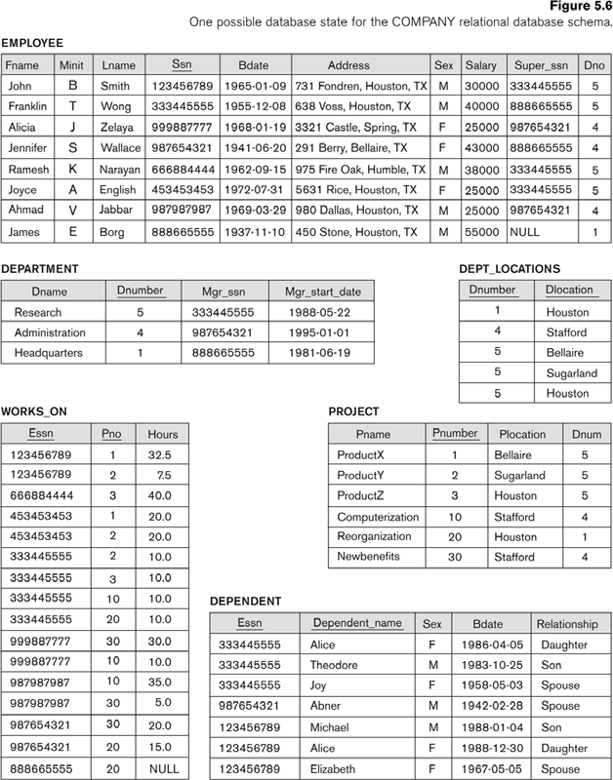
The following query results refer to this database state
Go, change the world
RV College of
Engineering
Manages : 1:1 relationship type between EMPLOYEE and DEPARTMENT. Employee participation is partial. Department participation is not clear from requirements
are the relationship types observed

Slide 15
Unary Relational Operations: PROJECT
Go, change the world
RV College of
Engineering
PROJECT Operation is denoted by π (pi)
This operation keeps certain columns (attributes) from a relation and discards the other columns.
PROJECT creates a vertical partitioning of Relation R in two relations
First contains the list of specified columns (attributes) in each tuple
The other contains the discarded attributes in each tuple
Example: To list each employee’s first and last name and salary, the following is used:
^{π}LNAME, FNAME,SALARY^{(EMPLOYEE)}

Slide 16
Unary Relational Operations: PROJECT (cont.)
Go, change the world
RV College of
Engineering
The general form of the project operation is:
^{π}<attribute list>^{(R)}
π (pi) is the symbol used to represent the project operation
<attribute list> is the desired list of attributes from relation R.
The project operation removes any duplicate tuples
This is because the result of the project operation must be a set of tuples
Mathematical sets do not allow duplicate elements.

Slide 17
Unary Relational Operations: PROJECT (contd.)
Go, change the world
RV College of
Engineering
PROJECT Operation Properties
The number of tuples in the result of projection π_{<list>}(R) is always less or equal to the number of tuples in R
If the list of attributes includes a key of R, then the number of tuples in the result of PROJECT is equal to the number of tuples in R
PROJECT is not commutative
π _{<list1>} (π _{<list2>} (R) ) = π _{<list1>} (R) as long as <list2> contains the attributes in <list1>

Slide 18
Unary Relational Operations: PROJECT (contd.)
Go, change the world
RV College of
Engineering
In SQL, the PROJECT attribute list is specified in the SELECT clause of a query. For example, the following operation:
πFN, LN, Salary(EMPLOYEE)
would correspond to the following SQL query:
SELECT DISTINCT FirstName, LastName, Salary
FROM EMPLOYEE

Slide 19
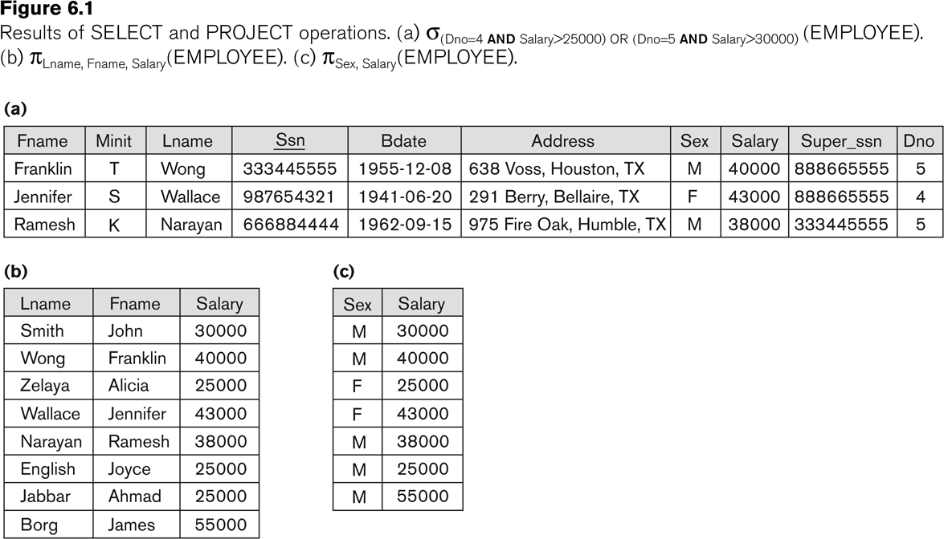
Examples of applying SELECT and PROJECT operations
Go, change the world
RV College of
Engineering
Manages : 1:1 relationship type between EMPLOYEE and DEPARTMENT. Employee participation is partial. Department participation is not clear from requirements
are the relationship types observed

Slide 20
Relational Algebra Expressions
Go, change the world
RV College of
Engineering
We may want to apply several relational algebra operations one after the other
Either we can write the operations as a single relational algebra expression by nesting the operations, or
We can apply one operation at a time and create intermediate result relations.
In the latter case, we must give names to the relations that hold the intermediate results.

Slide 21
Single expression versus sequence of relational operations (Example)
Go, change the world
RV College of
Engineering
To retrieve the first name, last name, and salary of all employees who work in department number 5, we must apply a select and a project operation
We can write a single relational algebra expression as follows:
^{π}FNAME, LNAME, SALARY^{(σ} DNO=5^{(EMPLOYEE))}
OR
We can explicitly show the sequence of operations, giving a name to each intermediate relation:
DEP5_EMPS ← σ _{DNO=5}(EMPLOYEE)
RESULT ← π _{FNAME, LNAME, SALARY} (DEP5_EMPS)

Slide 22
Unary Relational Operations: RENAME
Go, change the world
RV College of
Engineering
The RENAME operator is denoted by ρ (rho)
In some cases, we may want to rename the attributes of a relation or the relation name or both
Useful when a query requires multiple operations
Necessary in some cases(see JOIN operation later)
Manages : 1:1 relationship type between EMPLOYEE and DEPARTMENT. Employee participation is partial. Department participation is not clear from requirements

Slide 23
Unary Relational Operations: RENAME (contd.)
Go, change the world
RV College of
Engineering
The general RENAME operation ρ can be expressed by any of the following forms:
ρ_{S (B1, B2, …, Bn )}(R) changes both:
the relation name to S, and
the column (attribute) names to B1, B1, …..Bn
ρ_{S}(R) changes:
the relation name only to S
ρ_{(B1, B2, …, Bn )}(R) changes:
the column (attribute) names only to B1, B1, …..Bn
Manages : 1:1 relationship type between EMPLOYEE and DEPARTMENT.

Slide 24
Unary Relational Operations: RENAME (contd.)
Go, change the world
RV College of
Engineering
For convenience, we also use a shorthand for renaming attributes in an intermediate relation:
If we write:
RESULT ← π _{FNAME, LNAME, SALARY} (DEP5_EMPS)
RESULT will have the same attribute names as DEP5_EMPS (same attributes as EMPLOYEE)
If we write:
RESULT (F, M, L, S, B, A, SX, SAL, SU, DNO)←
RESULT (F.M.L.S.B,A,SX,SAL,SU, DNO)^{(DEP5_EMPS)}
The 10 attributes of DEP5_EMPS are renamed to F, M, L, S, B, A, SX, SAL, SU, DNO, respectively

Slide 25
Unary Relational Operations: RENAME (contd.)
Go, change the world
RV College of
Engineering
Renaming in SQL is accomplished by aliasing using AS, as in the following example:
SELECT E.Fname AS First_name, E.Lname AS Last_name, E.Salary AS Salary
FROM EMPLOYEE AS E
WHERE E.Dno=5,

Slide 26
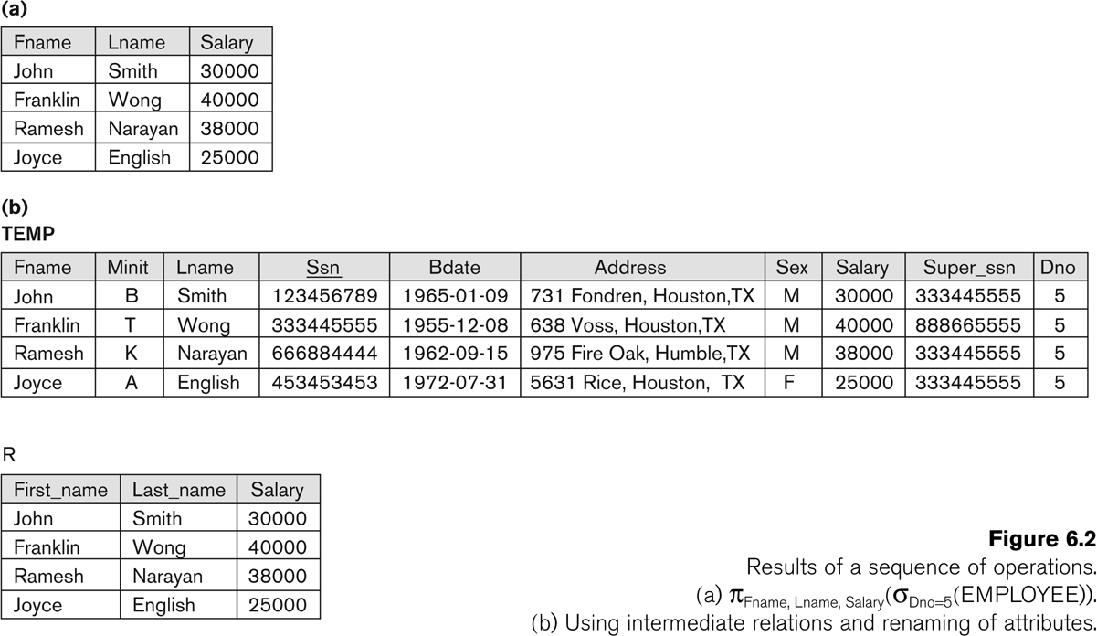
Example of applying multiple operations and RENAME
Go, change the world
RV College of
Engineering
Manages : 1:1 relationship type between EMPLOYEE and DEPARTMENT. Employee participation is partial. Department participation is not clear from requirements
are the relationship types observed

Slide 27
Relational Algebra Operations from Set Theory: UNION
Go, change the world
RV College of
Engineering
UNION Operation
Binary operation, denoted by ∪
The result of R ∪ S, is a relation that includes all tuples that are either in R or in S or in both R and S
Duplicate tuples are eliminated
The two operand relations R and S must be “type compatible” (or UNION compatible)
R and S must have same number of attributes
Each pair of corresponding attributes must be type compatible (have same or compatible domains)
Manages : 1:1 relationship type between EMPLOYEE and DEPARTMENT.

Slide 28
Relational Algebra Operations from Set Theory: UNION
Go, change the world
RV College of
Engineering
Example:
To retrieve the social security numbers of all employees who either work in department 5 (RESULT1 below) or directly supervise an employee who works in department 5 (RESULT2 below)
We can use the UNION operation as follows:
DEP5_EMPS ← σ_{DNO=5} (EMPLOYEE)
RESULT1 ← π _{SSN}(DEP5_EMPS)
RESULT2(SSN) ← π_{SUPERSSN}(DEP5_EMPS)
RESULT ← RESULT1 ∪ RESULT2
The union operation produces the tuples that are in either RESULT1 or RESULT2 or both

Slide 29
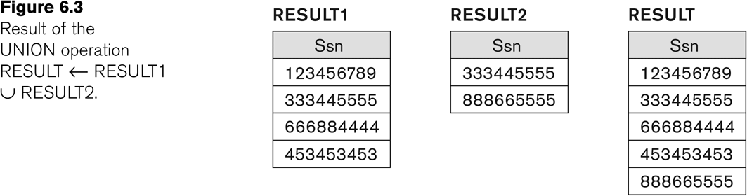
Example of the result of a UNION operation
Go, change the world
RV College of
Engineering
:UNION Example
1:1 relationship type between EMPLOYEE and DEPARTMENT. Employee participation is partial. Department participation is not clear from requirements
are the relationship types observed

Slide 30
Relational Algebra Operations from Set Theory
Go, change the world
RV College of
Engineering
Type Compatibility of operands is required for the binary set operation UNION ∪, (also for INTERSECTION ∩, and SET DIFFERENCE –, see next slides)
R1(A1, A2, ..., An) and R2(B1, B2, ..., Bn) are type compatible if:
they have the same number of attributes, and
the domains of corresponding attributes are type compatible (i.e. dom(Ai)=dom(Bi) for i=1, 2, ..., n).
The resulting relation for R1∪R2 (also for R1∩R2, or R1– R2, see next slides) has the same attribute names as the first operand relation R1 (by convention)

Slide 31
Relational Algebra Operations from Set Theory: INTERSECTION
Go, change the world
RV College of
Engineering
INTERSECTION is denoted by ∩
The result of the operation R ∩ S, is a relation that includes all tuples that are in both R and S
The attribute names in the result will be the same as the attribute names in R
The two operand relations R and S must be “type compatible”

Slide 32
Relational Algebra Operations from Set Theory: SET DIFFERENCE (cont.)
Go, change the world
RV College of
Engineering
SET DIFFERENCE (also called MINUS or EXCEPT) is denoted by –
The result of R – S, is a relation that includes all tuples that are in R but not in S
The attribute names in the result will be the same as the attribute names in R
The two operand relations R and S must be “type compatible”
1:1 EMPLOYEE and DEPARTMENT. Ee

Slide 33
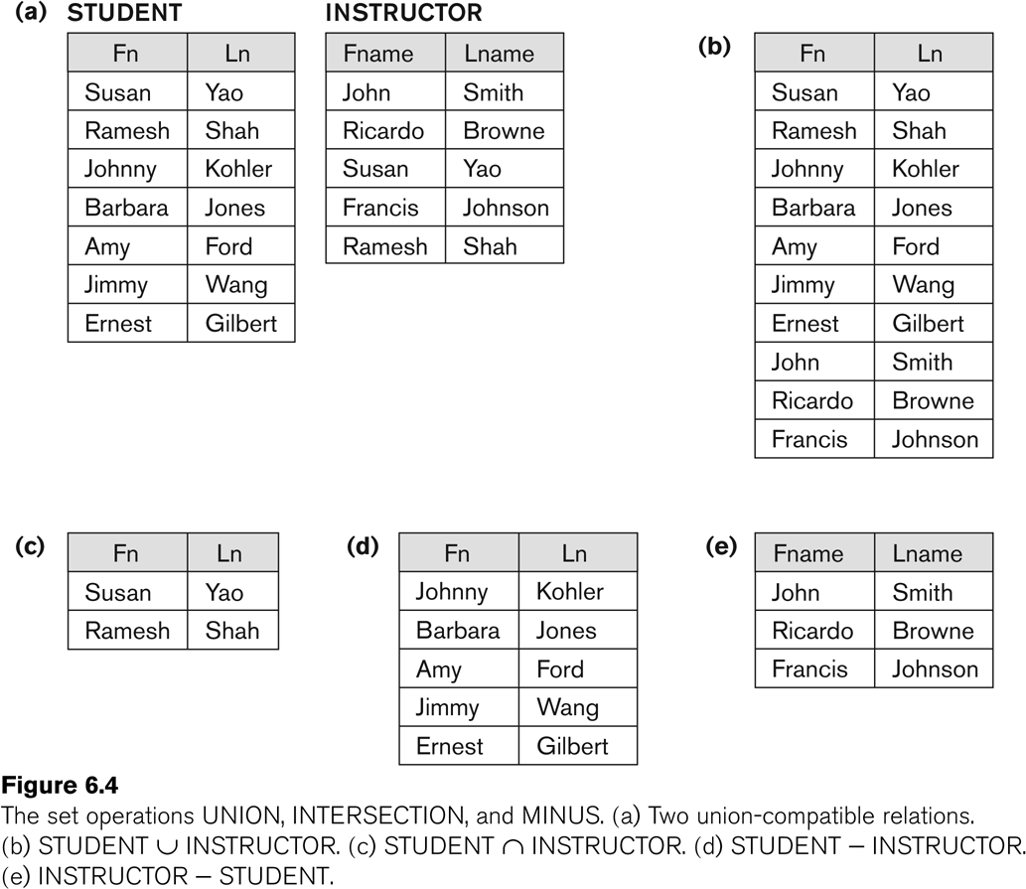
Example to illustrate the result of UNION, INTERSECT, and DIFFERENCE
Go, change the world
RV College of
Engineering
1:1 relationship type between EMPLOYEE and DEPARTMENT. Employee participation is partial. Department participation is not clear from requirements
are the relationship types observed

Slide 34
Some properties of UNION, INTERSECT, and DIFFERENCE
Go, change the world
RV College of
Engineering
Notice that both union and intersection are commutative operations; that is
R ∪ S = S ∪ R, and R ∩ S = S ∩ R
Both union and intersection can be treated as n-ary operations applicable to any number of relations as both are associative operations; that is
R ∪ (S ∪ T) = (R ∪ S) ∪ T
(R ∩ S) ∩ T = R ∩ (S ∩ T)
The minus operation is not commutative; that is, in general
R – S ≠ S – R
1:1 relationship type between EMPLOYEE and DEPARTMENT. Employee

Slide 35
Relational Algebra Operations from Set Theory: CARTESIAN PRODUCT
Go, change the world
RV College of
Engineering
CARTESIAN (or CROSS) PRODUCT Operation
This operation is used to combine tuples from two relations in a combinatorial fashion.
Denoted by R(A1, A2, . . ., An) x S(B1, B2, . . ., Bm)
Result is a relation Q with degree n + m attributes:
Q(A1, A2, . . ., An, B1, B2, . . ., Bm), in that order.
The resulting relation state has one tuple for each combination of tuples—one from R and one from S.
Hence, if R has n_{R} tuples (denoted as |R| = n_{R} ), and S has n_{S} tuples, then R x S will have n_{R} * n_{S} tuples.
The two operands do NOT have to be "type compatible”

Slide 36
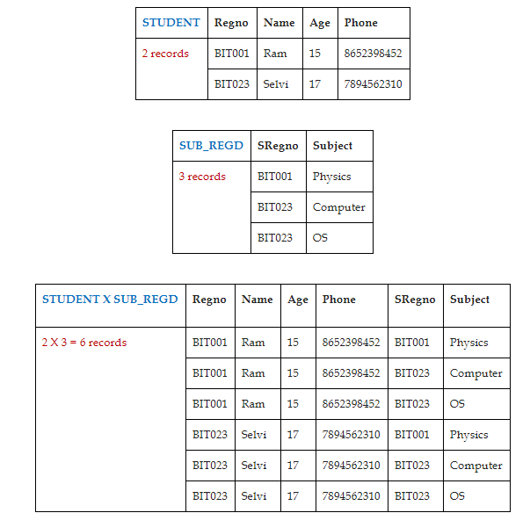
CARTESIAN PRODUCT
Go, change the world
RV College of
Engineering

Slide 37
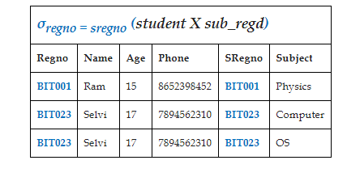
CARTESIAN PRODUCT
Go, change the world
RV College of
Engineering
Result: Joins the two relations student and sub_regd on regno and sregno attributes. If the values of the join attributes are same, only those records are combined as shown below.
σ_{regno = sregno} (student X sub_regd)

Slide 38
Relational Algebra Operations from Set Theory: CARTESIAN PRODUCT (cont.)
Go, change the world
RV College of
Engineering
Generally, CROSS PRODUCT is not a meaningful operation
Can become meaningful when followed by other operations
Example (not meaningful):
FEMALE_EMPS ← σ _{Gender=’F’}(EMPLOYEE)
EMPNAMES ← π _{FNAME, LNAME, SSN} (FEMALE_EMPS)
EMP_DEPENDENTS ← EMPNAMES x DEPENDENT
EMP_DEPENDENTS will contain every combination of EMPNAMES and DEPENDENT
whether or not they are actually related

Slide 39
Relational Algebra Operations from Set Theory: CARTESIAN PRODUCT (cont.)
Go, change the world
RV College of
Engineering
To keep only combinations where the DEPENDENT is related to the EMPLOYEE, we add a SELECT operation as follows
Example (meaningful):
FEMALE_EMPS ← σ _{Gender=’F’}(EMPLOYEE)
EMPNAMES ← π _{FNAME, LNAME, SSN} (FEMALE_EMPS)
EMP_DEPENDENTS ← EMPNAMES x DEPENDENT
ACTUAL_DEPS ← σ _{SSN=ESSN}(EMP_DEPENDENTS)
^{RESULT ← π} FNAME, LNAME, DEPENDENT_NAME ^{(ACTUAL_DEPS)}
RESULT will now contain the name of female employees and their dependents

Slide 40
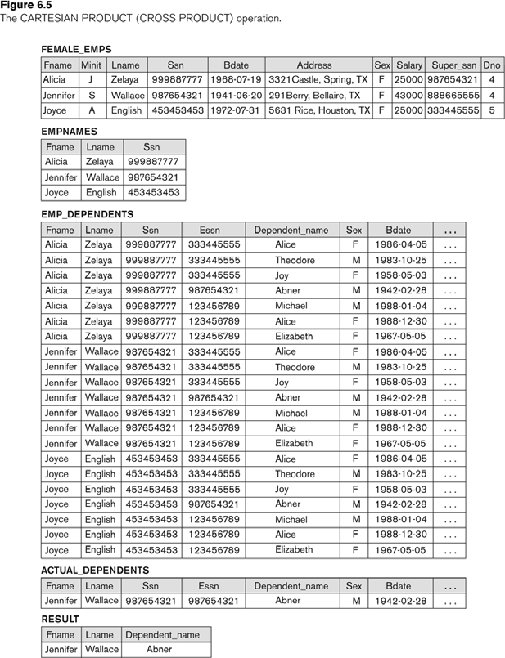
Example of applying CARTESIAN PRODUCT
Go, change the world
RV College of
Engineering
1:1 relationship type between EMPLOYEE and DEPARTMENT. Employee participation is partial. Department participation is not clear from requirements
are the relationship types observed

Slide 41
Relational Algebra Operations from Set Theory: CARTESIAN PRODUCT (cont.)
Go, change the world
RV College of
Engineering
JOIN Operation (denoted by )
The sequence of CARTESIAN PRODECT followed by SELECT is used quite commonly to identify and select related tuples from two relations
A special operation, called JOIN combines this sequence into a single operation
This operation is very important for any relational database with more than a single relation, because it allows us combine related tuples from various relations
The general form of a join operation on two relations R(A1, A2, . . ., An) and S(B1, B2, . . ., Bm) is:
R S equivalent to
<join condition>
where R and S can be any relations that result from general
relational algebra expressions.
1:1 relationship type between EMPLOYEE and DEPARTMENT. Employee

Slide 42
Relational Algebra Operations from Set Theory: CARTESIAN PRODUCT (cont.)
Go, change the world
RV College of
Engineering
Example: Suppose that we want to retrieve the name of the manager of each department.
To get the manager’s name, we need to combine each DEPARTMENT tuple with the EMPLOYEE tuple whose SSN value matches the MGRSSN value in the department tuple.
We do this by using the join operation.
DEPT_MGR ← DEPARTMENT MGRSSN=SSN ^{EMPLOYEE}
MGRSSN=SSN is the join condition
Combines each department record with the employee who manages the department
The join condition can also be specified as
DEPARTMENT.MGRSSN = EMPLOYEE.SSN

Slide 43
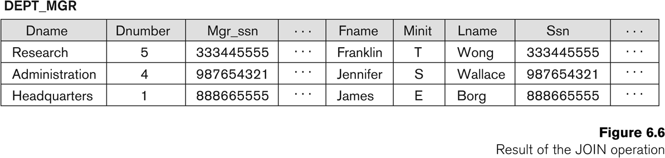
Relational Algebra Operations from Set Theory: CARTESIAN PRODUCT (cont.)
Go, change the world
RV College of
Engineering
1:1 relationship type between EMPLOYEE and DEPARTMENT. Employee participation is partial. Department participation is not clear from requirements
are the relationship types observed
DEPT_MGR ← DEPARTMENT MGRSSN=SSN
EMPLOYEE

Slide 44
Some properties of JOIN
Go, change the world
RV College of
Engineering
Consider the following JOIN operation:
R(A1, A2, . . ., An) S(B1, B2, . . ., Bm)
R.Ai=S.Bj
Result is a relation Q with degree n + m attributes:
Q(A1, A2, . . ., An, B1, B2, . . ., Bm), in that order.
The resulting relation state has one tuple for each combination of tuples—r from R and s from S, but only if they satisfy the join condition r[Ai]=s[Bj]
Hence, if R has n_{R} tuples, and S has n_{S} tuples, then the join result will generally have less than n_{R} * n_{S} tuples.
Only related tuples (based on the join condition) will appear in the result
1:1 relationship type between EMPLOYEE and DEPARTMENT. Employee participation is partial. Department participation is not clear from requirements
are the relationship types observed

Slide 45
Theta JOIN
Go, change the world
RV College of
Engineering
The general case of JOIN operation is called a
Theta-join: R theta S equivalent to R1 ⋈ _{<join condition>} R2
The join condition is called theta
Here, the <join condition> is of the form R1.a θ R2.b, and θ is any of the comparison operators {=, <, <=, >, >=, ≠}
Theta can be any general boolean expression on the attributes of R and S; for example:
R.Ai<S.Bj AND (R.Ak=S.Bl OR R.Ap<S.Bq)
Most join conditions involve one or more equality conditions “AND”ed together; for example:
R.Ai=S.Bj AND R.Ak=S.Bl AND R.Ap=S.Bq

Slide 46
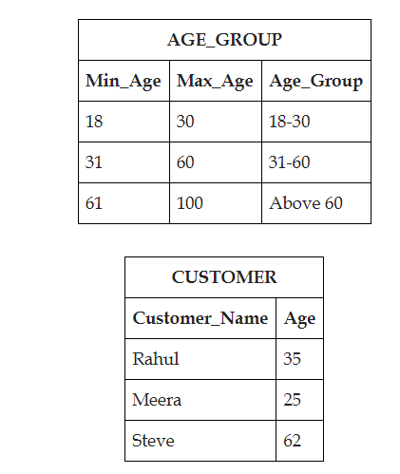
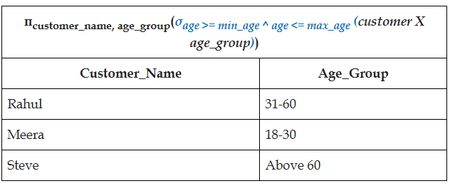
Example of Theta JOIN
Go, change the world
RV College of
Engineering
Write a query to Display the customer name and the age-group for each customer
π_{customer_name, age_group}(σage >= min_age ^ age <= max_age (customer X age_group))

Slide 47
Binary Relational Operations: EQUIJOIN
Go, change the world
RV College of
Engineering
EQUIJOIN Operation
The most common use of join involves join conditions with equality comparisons only
Such a join, where the only comparison operator used is =, is called an EQUIJOIN.
In the result of an EQUIJOIN we always have one or more pairs of attributes (whose names need not be identical) that have identical values in every tuple.
The JOIN seen in the previous example was an EQUIJOIN.
1:1 relationship type between EMPLOYEE and DEPARTMENT. Employee participation is partial. Department participation is not clear from requirements
are the relationship types observed

Slide 48
EQUIJOIN - Example
Go, change the world
RV College of
Engineering
1:1 relationship type between EMPLOYEE and DEPARTMENT. Employee participation is partial. Department participation is not clear from requirements
are the relationship types observed
Result: Joins the two relations student and sub_regd on regno and sregno attributes. If the values of the join attributes are same, only those records are combined as shown below.
σ_{regno = sregno} (student X sub_regd)

Slide 49
Binary Relational Operations: NATURAL JOIN Operation
Go, change the world
RV College of
Engineering
NATURAL JOIN Operation
Another variation of JOIN called NATURAL JOIN denoted by * was created to get rid of the second (superfluous) attribute in an EQUIJOIN condition.
because one of each pair of attributes with identical values is superfluous
The standard definition of natural join requires that the two join attributes, or each pair of corresponding join attributes, have the same name in both relations
If this is not the case, a renaming operation is applied first.
1:1 relationship type between EMPLOYEE and DEPARTMENT. Employee participation is partial. Department participation is not clear from requirements
are the relationship types observed

Slide 50

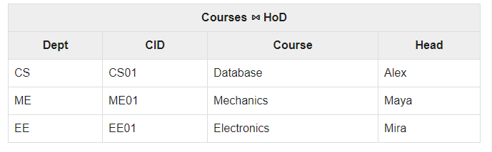
Binary Relational Operations: NATURAL JOIN Operation
Go, change the world
RV College of
Engineering
Courses * HoD
Courses ⋈ _{<courses.Dept = HoD.Dept>} HoD
σ_{courses.Dept = HoD.Dept} (Courses X HoD)
Dept | CID | Course | Dept | Head
CS | CS01 | Database | CS | Alex
ME | ME01 | Mechanics | ME | Maya
EE | EE01 | Electronics | EE | Mira

Slide 51
Binary Relational Operations NATURAL JOIN (contd.)
Go, change the world
RV College of
Engineering
Example: To apply a natural join on the DNUMBER attributes of DEPARTMENT and DEPT_LOCATIONS, it is sufficient to write:
DEPT_LOCS ← DEPARTMENT * DEPT_LOCATIONS
Only attribute with the same name is DNUMBER
An implicit join condition is created based on this attribute: DEPARTMENT.DNUMBER=DEPT_LOCATIONS.DNUMBER
Another example: Q ← R(A,B,C,D) * S(C,D,E)
The implicit join condition includes each pair of attributes with the same name, “AND”ed together:
R.C=S.C AND R.D.S.D
Result keeps only one attribute of each such pair:
Q(A,B,C,D,E)
1:1 relationship type between EMPLOYEE and DEPARTMENT. Employee participation is partial. Department participation is not clear from requirements
are the relationship types observed

Slide 52
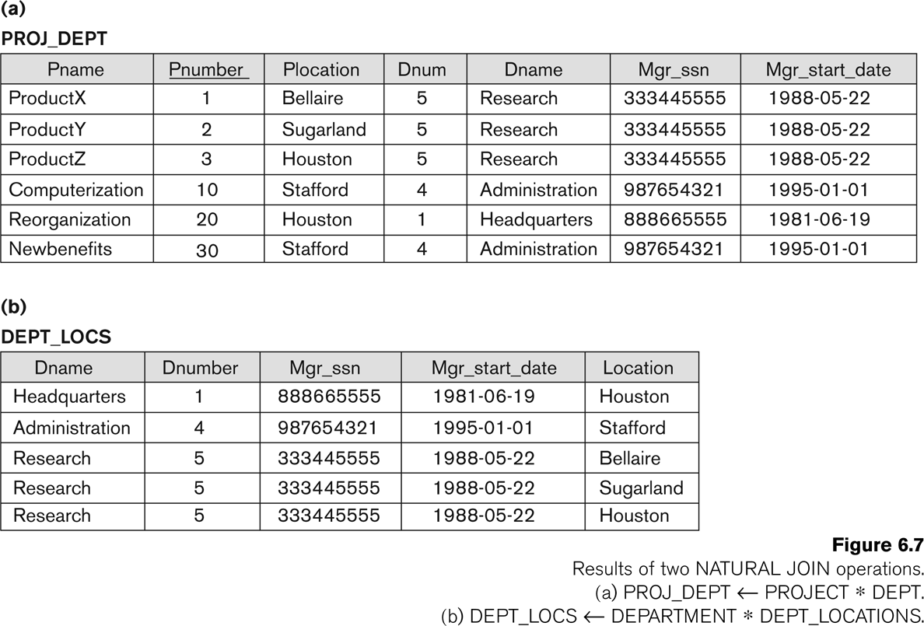
Example of NATURAL JOIN operation
Go, change the world
RV College of
Engineering
1:1 relationship type between EMPLOYEE and DEPARTMENT. Employee participation is partial. Department participation is not clear from requirements
are the relationship types observed

Slide 53
Complete Set of Operations
Go, change the world
RV College of
Engineering
The set of operations including SELECT σ, PROJECT π , UNION ∪, DIFFERENCE − , RENAME ρ, and CARTESIAN PRODUCT X is called a complete set because any other relational algebra expression can be expressed by a combination of these five operations.
For example:
R ∩ S = (R ∪ S ) – ((R − S) ∪ (S − R))
R <join condition>^{S = σ} <join condition> ^{(R X S)}

Slide 54
Binary Relational Operations: DIVISION
Go, change the world
RV College of
Engineering
DIVISION Operation
The division operation is applied to two relations R(Z) ÷ S(X), where X subset Z.
Let Y = Z - X (and hence Z = X ∪ Y); that is, let Y be the set of attributes of R that are not attributes of S.
The result of DIVISION is a relation T(Y) that includes a tuple t if tuples t_{R} appear in R with t_{R} [Y] = t, and with
t_{R} [X] = t_{s} for every tuple t_{s} in S.
For a tuple t to appear in the result T of the DIVISION, the values in t must appear in R and it should be in combination with every tuple in S.

Slide 55
Binary Relational Operations: DIVISION
Go, change the world
RV College of
Engineering
Division operator A÷B can be applied if and only if:
Attributes of B is proper subset of Attributes of A.
The relation returned by division operator will have attributes = (All attributes of A – All Attributes of B)
The relation returned by division operator will return those tuples from relation A which are associated to every tuple of B’s relation.
If you have a query of the kind find the students who play ALL the sports.
If you have a query of the kind find the employees who work on ALL the projects on which Mr. Smith works.
1:1 relationship type between EMPLOYEE and DEPARTMENT. Employee

Slide 56
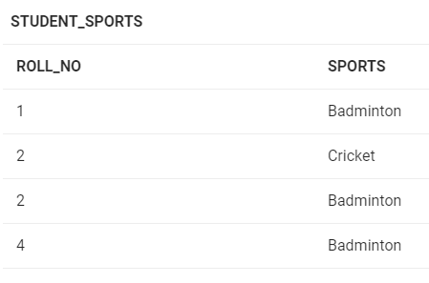
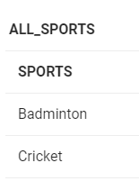
Binary Relational Operations: DIVISION
Go, change the world
RV College of
Engineering
If you have a query of the kind find the students who play ALL the sports.
The operation is valid as attributes in ALL_SPORTS is a proper subset of attributes in STUDENT_SPORTS.
The attributes in resulting relation will have attributes {ROLL_NO,SPORTS} - {SPORTS}= ROLL_NO
The tuples in resulting relation will have those ROLL_NO which are associated with every tuple of B’s relation {Badminton, Cricket}.
ROLL_NO 1 and 4 are associated to Badminton only.
ROLL_NO 2 is associated to all tuples of B. So the resulting relation will be:

Slide 57
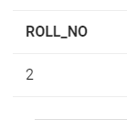
Binary Relational Operations: DIVISION
Go, change the world
RV College of
Engineering
If you have a query of the kind find the students who play ALL the sports.
ROLL_NO 2 is associated to all tuples of B. So the resulting relation will be:

Slide 58
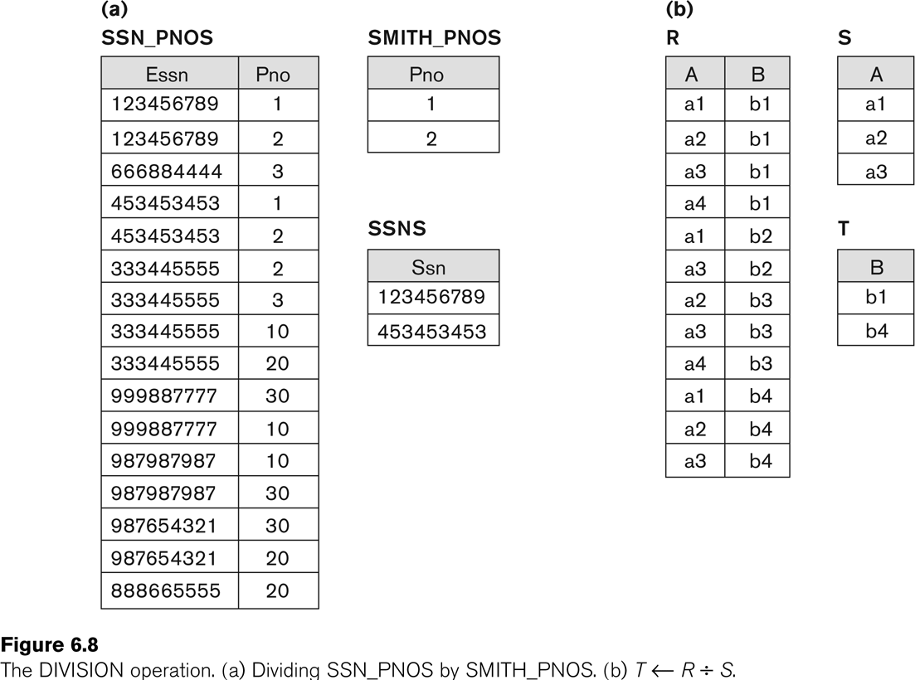
Example of DIVISION
Go, change the world
RV College of
Engineering
1:1 relationship type between EMPLOYEE and DEPARTMENT. Employee participation is partial. Department participation is not clear from requirements
are the relationship types observed

Slide 59
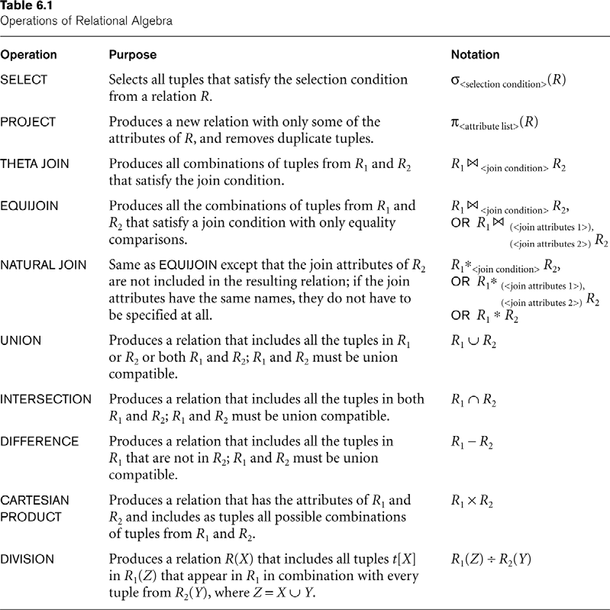
Recap of Relational Algebra Operations
Go, change the world
RV College of
Engineering
1:1 relationship type between EMPLOYEE and DEPARTMENT. Employee participation is partial. Department participation is not clear from requirements
are the relationship types observed

Slide 60
Additional Relational Operations: Aggregate Functions and Grouping
Go, change the world
RV College of
Engineering
A type of request that cannot be expressed in the basic relational algebra is to specify mathematical aggregate functions on collections of values from the database.
Examples of such functions include retrieving the average or total salary of all employees or the total number of employee tuples.
These functions are used in simple statistical queries that summarize information from the database tuples.
Common functions applied to collections of numeric values include
SUM, AVERAGE, MAXIMUM, and MINIMUM.
The COUNT function is used for counting tuples or values.
1:1 relationship type between EMPLOYEE and DEPARTMENT. Employee participation is partial. Department participation is not clear from requirements
are the relationship types observed

Slide 61
Aggregate Function Operation
Go, change the world
RV College of
Engineering
Use of the Aggregate Functional operation ℱ
ℱ_{MAX Salary} (EMPLOYEE) retrieves the maximum salary value from the EMPLOYEE relation
ℱ_{MIN Salary} (EMPLOYEE) retrieves the minimum Salary value from the EMPLOYEE relation
ℱ_{SUM Salary} (EMPLOYEE) retrieves the sum of the Salary from the EMPLOYEE relation
ℱ_{COUNT SSN, AVERAGE Salary} (EMPLOYEE) computes the count (number) of employees and their average salary
Note: count just counts the number of rows, without removing duplicates

Slide 62
Using Grouping with Aggregation
Go, change the world
RV College of
Engineering
The previous examples all summarized one or more attributes for a set of tuples
Maximum Salary or Count (number of) Ssn
Grouping can be combined with Aggregate Functions
Example: For each department, retrieve the DNO, COUNT SSN, and AVERAGE SALARY
A variation of aggregate operation ℱ allows this:
Grouping attribute placed to left of symbol
Aggregate functions to right of symbol
DNO ^{ℱ}COUNT SSN, AVERAGE Salary ^{(EMPLOYEE)}
Above operation groups employees by DNO (department number) and computes the count of employees and average salary per department
1:1 relationship type between EMPLOYEE and DEPARTMENT. Employee participation is partial. Department participation is not clear from requirements
are the relationship types observed

Slide 63
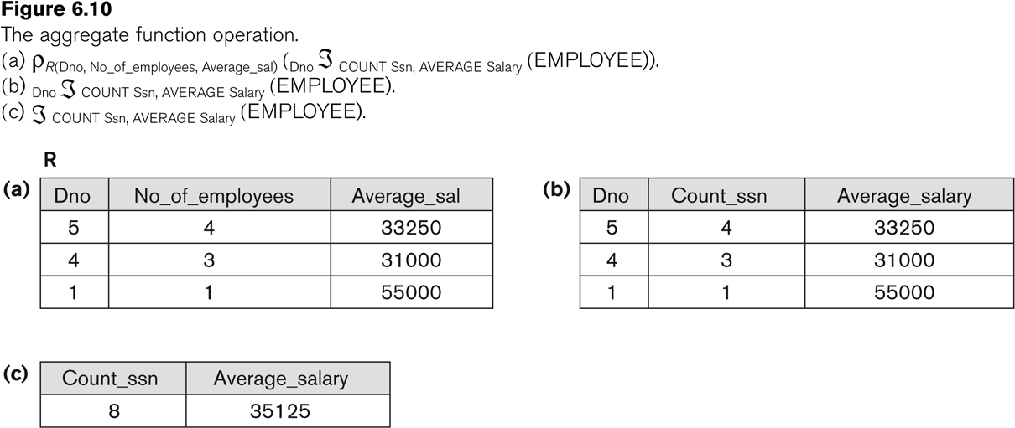
Examples of applying aggregate functions and grouping
Go, change the world
RV College of
Engineering
1:1 relationship type between EMPLOYEE and DEPARTMENT. Employee participation is partial. Department participation is not clear from requirements
are the relationship types observed

Slide 64
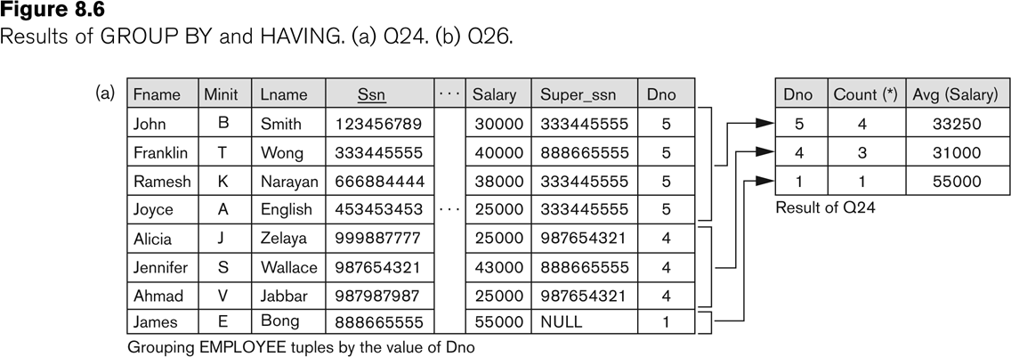
Illustrating aggregate functions and grouping
Go, change the world
RV College of
Engineering
1:1 relationship type between EMPLOYEE and DEPARTMENT. Employee participation is partial. Department participation is not clear from requirements
are the relationship types observed

Slide 65
Additional Relational Operations (cont.)
Go, change the world
RV College of
Engineering
The OUTER JOIN Operation
In NATURAL JOIN and EQUIJOIN, tuples without a matching (or related) tuple are eliminated from the join result
Tuples with null in the join attributes are also eliminated
This results in loss of information.
A set of operations, called OUTER joins, can be used when we want to keep all the tuples in R, or all those in S, or all those in both relations in the result of the join, regardless of whether or not they have matching tuples in the other relation.

Slide 66
Additional Relational Operations (cont.)
Go, change the world
RV College of
Engineering
The left outer join operation keeps every tuple in the first or left relation R in R S; if no matching tuple is found in S, then the attributes of S in the join result are filled or “padded” with null values.
A similar operation, right outer join, keeps every tuple in the second or right relation S in the result of R S.
A third operation, full outer join, denoted by keeps all tuples in both the left and the right relations when no matching tuples are found, padding them with null values as needed.
1:1 relationship type between EMPLOYEE and DEPARTMENT. Employee participation is partial. Department participation is not clear from requirements
are the relationship types observed

Slide 67
Additional Relational Operations (cont.)
Go, change the world
RV College of
Engineering
Emp (E) E D
1:1 relationship type between EMPLOYEE and DEPARTMENT. Employee participation is partial. Department participation is not clear from requirements
Dept(D) E D
Emp_id | E-name | Mobile | Dept-no
101 | RAM | 99999999 | D-10
103 | MOHAN | 88888888 | D-11
104 | AMIT | 88777777 | D-10
107 | AJAY | 98887777 | NULL
Emp_id | E-name | Mobile | Dept-no | Dept-name
101 | RAM | 99999999 | D-10 | Marketing
103 | MOHAN | 88888888 | D-11 | Financial
104 | AMIT | 88777777 | D-10 | Marketing
107 | AJAY | 98887777 | NULL | NULL
Dept-no | Dept-name
D-10 | Marketing
D-11 | Financial
D-12 | SALES
Emp_id | E-name | Mobile | Dept-no | Dept-name
101 | RAM | 99999999 | D-10 | Marketing
103 | MOHAN | 88888888 | D-11 | Financial
104 | AMIT | 88777777 | D-10 | Marketing
NULL | NULL | NULL | D-12 | SALES

Slide 68
Additional Relational Operations (cont.)
Go, change the world
RV College of
Engineering
Emp (E) E D
1:1 relationship type between EMPLOYEE and DEPARTMENT. Employee participation is partial. Department participation is not clear from requirements
Dept(D)
Emp_id | E-name | Mobile | Dept-no
101 | RAM | 99999999 | D-10
103 | MOHAN | 88888888 | D-11
104 | AMIT | 88777777 | D-10
107 | AJAY | 98887777 | NULL
Emp_id | E-name | Mobile | Dept-no | Dept-name
101 | RAM | 99999999 | D-10 | Marketing
103 | MOHAN | 88888888 | D-11 | Financial
104 | AMIT | 88777777 | D-10 | Marketing
107 | AJAY | 98887777 | NULL | NULL
NULL | NULL | NULL | D-12 | SALES
Dept-no | Dept-name
D-10 | Marketing
D-11 | Financial
D-12 | SALES

Slide 69
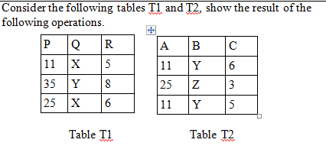
Exercise on Outer Joins
Go, change the world
RV College of
Engineering
T1 _{T1.P = T2.A} T2
T1 _{T1.Q = T2.B} T2
T1 _{T1.R = T2.C} T2
T1 _{T1.R = T2.C} T2
T1 ( _{T1.P = T2.A AND T1.R = T2.C)} T2

Slide 70
Additional Relational Operations (cont.)
Go, change the world
RV College of
Engineering
OUTER UNION Operations
The outer union operation was developed to take the union of tuples from two relations if the relations are not type compatible.
This operation will take the union of tuples in two relations R(X, Y) and S(X, Z) that are partially compatible, meaning that only some of their attributes, say X, are type compatible.
The attributes that are type compatible are represented only once in the result, and those attributes that are not type compatible from either relation are also kept in the result relation T(X, Y, Z).

Slide 71
Additional Relational Operations (cont.)
Go, change the world
RV College of
Engineering
Example: An outer union can be applied to two relations whose schemas are STUDENT(Name, SSN, Department, Advisor) and INSTRUCTOR(Name, SSN, Department, Rank).
Tuples from the two relations are matched based on having the same combination of values of the shared attributes— Name, SSN, Department.
If a student is also an instructor, both Advisor and Rank will have a value; otherwise, one of these two attributes will be null.
The result relation STUDENT_OR_INSTRUCTOR will have the following attributes:
STUDENT_OR_INSTRUCTOR (Name, SSN, Department, Advisor, Rank)

Slide 72
Examples of Queries in Relational Algebra : Procedural Form
Go, change the world
RV College of
Engineering
Q1: Retrieve the name and address of all employees who work for the ‘Research’ department.
RESEARCH_DEPT ← σ DNAME=’Research’ (DEPARTMENT)
RESEARCH_EMPS ← (RESEARCH_DEPT _{DNUMBER= DNO}EMPLOYEE)
RESULT ← π FNAME, LNAME, ADDRESS (RESEARCH_EMPS)
Q6: Retrieve the names of employees who have no dependents.
ALL_EMPS ← π SSN(EMPLOYEE)
EMPS_WITH_DEPS(SSN) ← π ESSN(DEPENDENT)
EMPS_WITHOUT_DEPS ← (ALL_EMPS - EMPS_WITH_DEPS)
RESULT ← π LNAME, FNAME (EMPS_WITHOUT_DEPS * EMPLOYEE)
1:1 relationship type between EMPLOYEE and DEPARTMENT. Employee

Slide 73
Examples of Queries in Relational Algebra – Single expressions
Go, change the world
RV College of
Engineering
As a single expression, these queries become:
Q1: Retrieve the name and address of the employees who work for the ‘Research’ department.
π _{Fname, Lname, Address} (σ Dname= ‘Research’
(DEPARTMENT Dnumber=Dno(EMPLOYEE))
Q6: Retrieve the names of employees who have no dependents.
π _{Lname, Fname}((π _{Ssn} (EMPLOYEE) − ρ _{Ssn} (π Essn
(DEPENDENT))) ∗ EMPLOYEE)
tionship type between EMPLOYEE and DEPARTMENT. Employee participation is partial. Department participation is not clear from requirements

Slide 74
Go, change the world
RV College of
Engineering
Thank YOU

Slide 75
Class Link
Go, change the world
RV College of
Engineering
Class 15
https://drive.google.com/file/d/1yeQScWMTKOvN1099JfaGxnq_2wENjSXQ/view?usp=sharing
Class 16
https://drive.google.com/file/d/15sMm2_g0_P0GzUwK19DbQ_eK4fN4nst6/view?usp=sharing

